Slide 2
Financial Accounting & Ratio Analysis

Slide 3
National Income Accounting
National Income Accounting is a set of principles and methods, that are used to measure the income and production of a country.
The purpose of National Income Accounting is to obtain some measure of the performance of the aggregate economy.
There are basically two ways of measuring national economic activity:
as the money value of the total production of goods and services during a given period (usually a year) or
as the total of incomes derived from economic activity after allowance has been made for capital consumption.

Slide 4
GNP as a measure
The most commonly used indicator of national output is the Gross National Product (GNP), which is a measure of the total market value of currently produced finished goods and the value of services rendered.
This excludes Intermediate products and replacement investment in capital goods.
But includes profits earned by nation’s business corporation’s foreign operations and earnings of workers working abroad.
Determination of market value of the goods and services is difficult and somewhat imprecise. Nonetheless the use of a common basis of valuation makes it possible to obtain a total that fairly represents the level of output of a country.
The rule that only currently produced goods and services should be counted ensures that only production occurring in the course of a given year is included

Slide 5
GDP vs. GNP
GDP (or Gross Domestic Product) and GNP (Gross National Product) measure the size and strength
of an economy but are calculated and used in different ways.
Comparison chart
 | GDP | GNP
Stands for | Gross Domestic Product | Gross National Product
Definition | An estimated value of the total worth of a country’s production and services, within its boundary, by its nationals and foreigners, calculated over the course on one year. | An estimated value of the total worth of production and services, by citizens of a country, on its land or on foreign land, calculated over the course on one year.
Formula for Calculation | GDP = consumption + investment + (government spending) + (exports − imports). | GNP = GDP + NR (Net income inflow from assets abroad or Net Income Receipts) - NP (Net payment outflow to foreign assets).
Uses | Business, Economic Forecasting. | Business, Economic Forecasting.

Slide 6
GNP vs NNP
Gross National Product [GNP] is the gross value of all the final products without deducting the depreciation of fixed capital. It is the total of market value of final goods and services produced in a year. Net National Product [NNP] is the value of net output in an economy during a period of one year. The net national product is calculated by deducting depreciation from the gross national product. NNP = GNP - Depreciation

Slide 7
Income Approach vs Expenditure Approach
GDP is generally understood to represent the health of a nation’s economy, and most people realize that if GDP is growing, things are going well, while if it’s falling things have turned sour in the economy. But what, precisely, does GDP measures? There are two primary methods for measuring GDP, which should yield the same result even though they measure completely different factors.
The income approach: measures the total incomes earned by households in a nation in a year.
The expenditure approach: measures the total amount spent on the goods produced by a country in a year.
Notes:
The INCOME APPROACH calculates GDP on the basis of the sum total of all payments (income) received by various economic agents engaged in different production activities. Thus, firstly, it includes the wages and salaries (W) of individuals engaged in gainful employment in public or private institutions including social benefits as also those that are self-employed.
Secondly, it includes the interest income (I) received by lenders of capital particularly financial capital. Any interest that you pay on your bank loan forms a part of interest income for the bank. As a corollary, any interest that you receive on your bank deposits also forms a part of interest income since you are the lender of financial capital to the bank.
The third component is the rent (R) earned by owners of land, usually called unearned income since it is not through any gainful employment.
Finally, the profits or losses (P/L) that accrue to the producers/entrepreneurs forms the last component. It should be noted that while profits add to the GDP (+), losses similarly DEDUCT from the GDP (-).
Thus, Y = W + I + R +/- P/L

Slide 8
Financial & Economic Analysis
The main goal of financial analysis (FA) is to examine the financial returns to Production projects.
This is aimed at demonstrating that all actors have enough financial incentive to participate.
Economic Analysis (EA) is carried out to assess the projects efficiency in terms of its net contribution to the national economic and social welfare.

Slide 9
Financial & Economic Analysis
Financial and Economic Analysis (FEA) of investment projects is
an appraisal requirement of most governments and International Financing Institutions (IFIs).
It provides the grounds for making decisions on investment financing a proposed project based on its financial and economic viability.

Slide 10
Financial & Economic Analysis
The core of financial and economic analysis is to put a monetary value on costs and benefits.
Costs are usually known, but some benefits may not have a price, and can be difficult to value (= "non-tangible"). This is the case of many projects, notably in the social sectors.
Cost - Benefit analysis is used to value projects with tangible benefits; and
Cost – Effectiveness analysis to analyse projects with non- - tangible benefits.

Slide 11
Projects are mix of Financial and Non-financial Benefits
In no case should one assume that because some benefits are non-tangible, no financial and economic analysis is possible.
As most projects include a mixture of tangible and non-tangible benefits, both types of analyses should normally be done.

Slide 12
Goals of Financial management
Primary goal of the Financial Management is to maximize the wealth of the company’s shareholders (owners) by increasing the market value (price) of their shares
This may at times may conflict with
social / ethical goals (for example, fair market operations, pollution control compliance etc.)
interests of the executive managements (for example, denying short-term compensation etc.)
Financial management’s role is to maintain a balanced financial health of the organization, so that it can service the borrowings in an appropriate manner to create goodwill with the lenders and to reduce the cost of future borrowings, if required.
Financial management also helps building market goodwill through attractive returns to the investors at an acceptable level of risk.

Slide 13
Functions of Finance
Routine Functions:
Cash management(receipt and disbursement of funds)
Credit management
Inventory control
Short-term financing
Exchange and interest rate hedging
Bank relations
Intermittent Functions:
Leasing
Stock issues
Capital budgeting
Dividend decisions
Long and medium term financing, where the objective is to
raise funds for the firm at minimal cost and acceptable risk
invest those funds in company assets so as to earn an attractive return given acceptable risks

Slide 14
Balance Sheet
A financial statement that summarizes a company's assets, liabilities and shareholders' equity at a specific point in time. Balance Sheet is the snap shot of financial strength of any company at any point of time. It must follow the following formula:
Assets = Outside Liabilities + Shareholders' Equity
It's called a balance sheet because the two sides balance out. This makes sense:
a company has to pay for all the things it has (assets)
by
either borrowing money (liabilities) or getting it from shareholders (shareholders' equity).
Accounts such as cash, inventory and property are on the asset side of the balance sheet, while on the liability side there are accounts such as accounts payable or long-term debt, apart from the share holder’s money (equity).

Slide 15
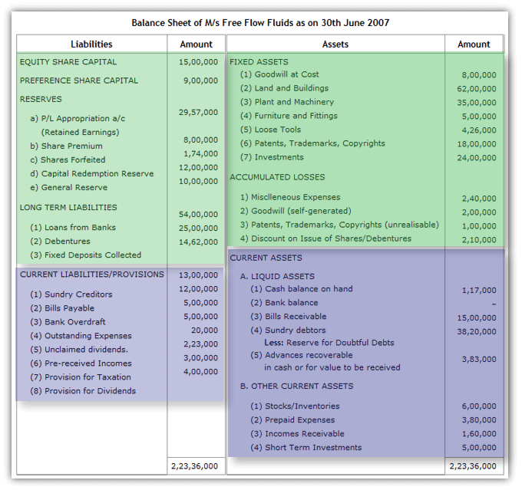
Sample Balance Sheet

Slide 16
Income Statement
The income statement is the one of the three major financial statements. The other two are the balance sheet and the statement of cash flows.
This measures a company's financial performance over a specific accounting period.
Financial performance is assessed by giving a summary of how the business incurs its revenues and expenses through both operating and non-operating activities.
Financial performance is for a time period, which is specified in its heading. The period of time that the statement covers is chosen by the business and will vary. For example, the heading may state:
"For the Three Months Ended December 31, 2012" (The period of October 1 through December 31, 2012.)
"The Financial Year Ended 31stMarch, 2013" (The period of April 1, 2012 through 31st March, 2013.)

Slide 17
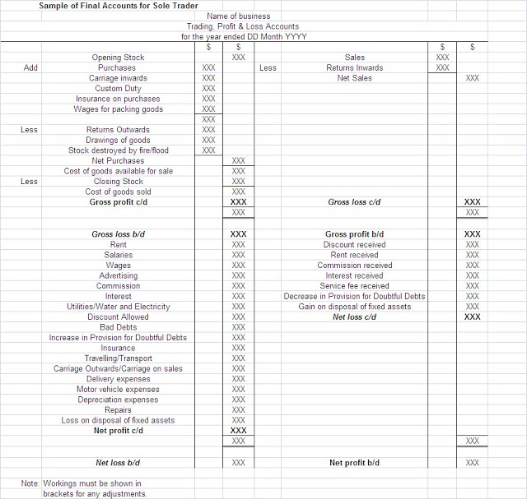
Sample Trading, Profit & Loss Account

Slide 18
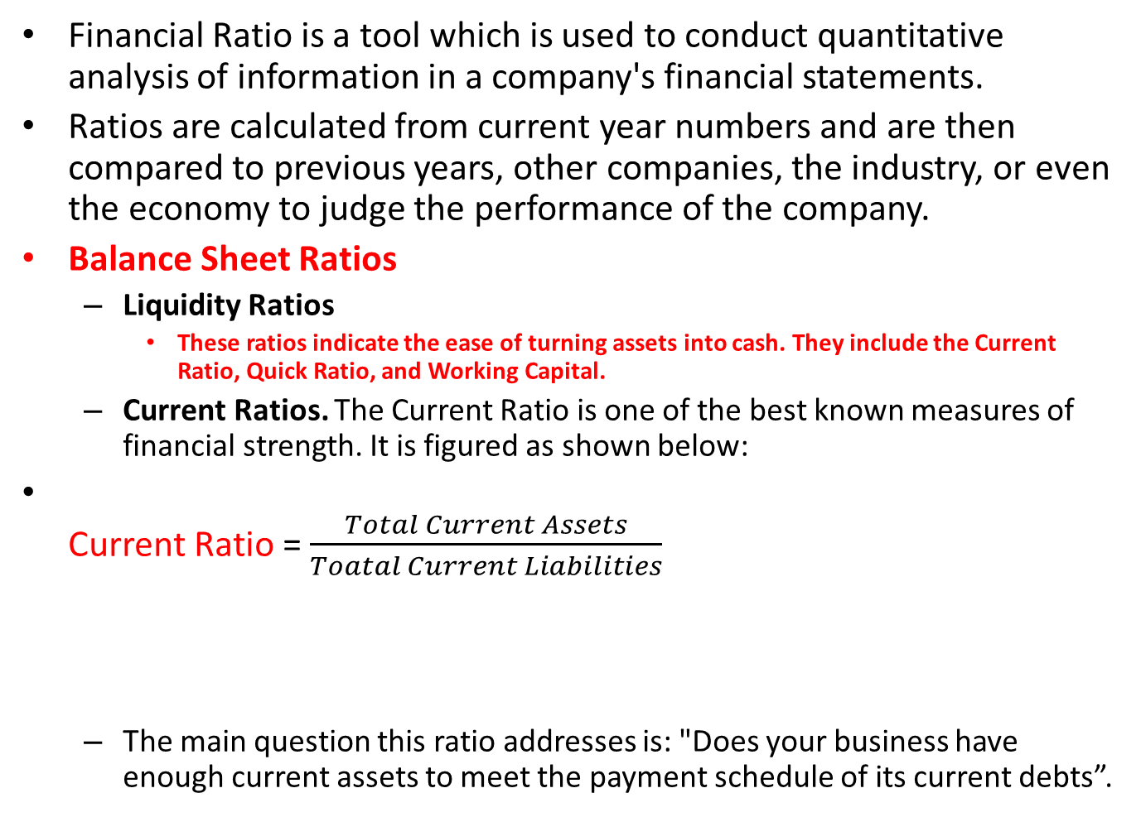
Financial Ratios
Financial Ratio is a tool which is used to conduct quantitative analysis of information in a company's financial statements.
Ratios are calculated from current year numbers and are then compared to previous years, other companies, the industry, or even the economy to judge the performance of the company.
Balance Sheet Ratios
Liquidity Ratios
These ratios indicate the ease of turning assets into cash. They include the Current Ratio, Quick Ratio, and Working Capital.
Current Ratios. The Current Ratio is one of the best known measures of financial strength. It is figured as shown below:
Current Ratio = $\frac{Total Current Assets}{Toatal Current Liabilities}$
The main question this ratio addresses is: "Does your business have enough current assets to meet the payment schedule of its current debts”.
Current Assets include Stock,
Short term investments, Debtors,
Receivables, Bank & Cash Account, etc.
Current Liabilities include Creditors,
Outstanding wages/salaries and other expenses,
Bank overdrafts etc.

Slide 19
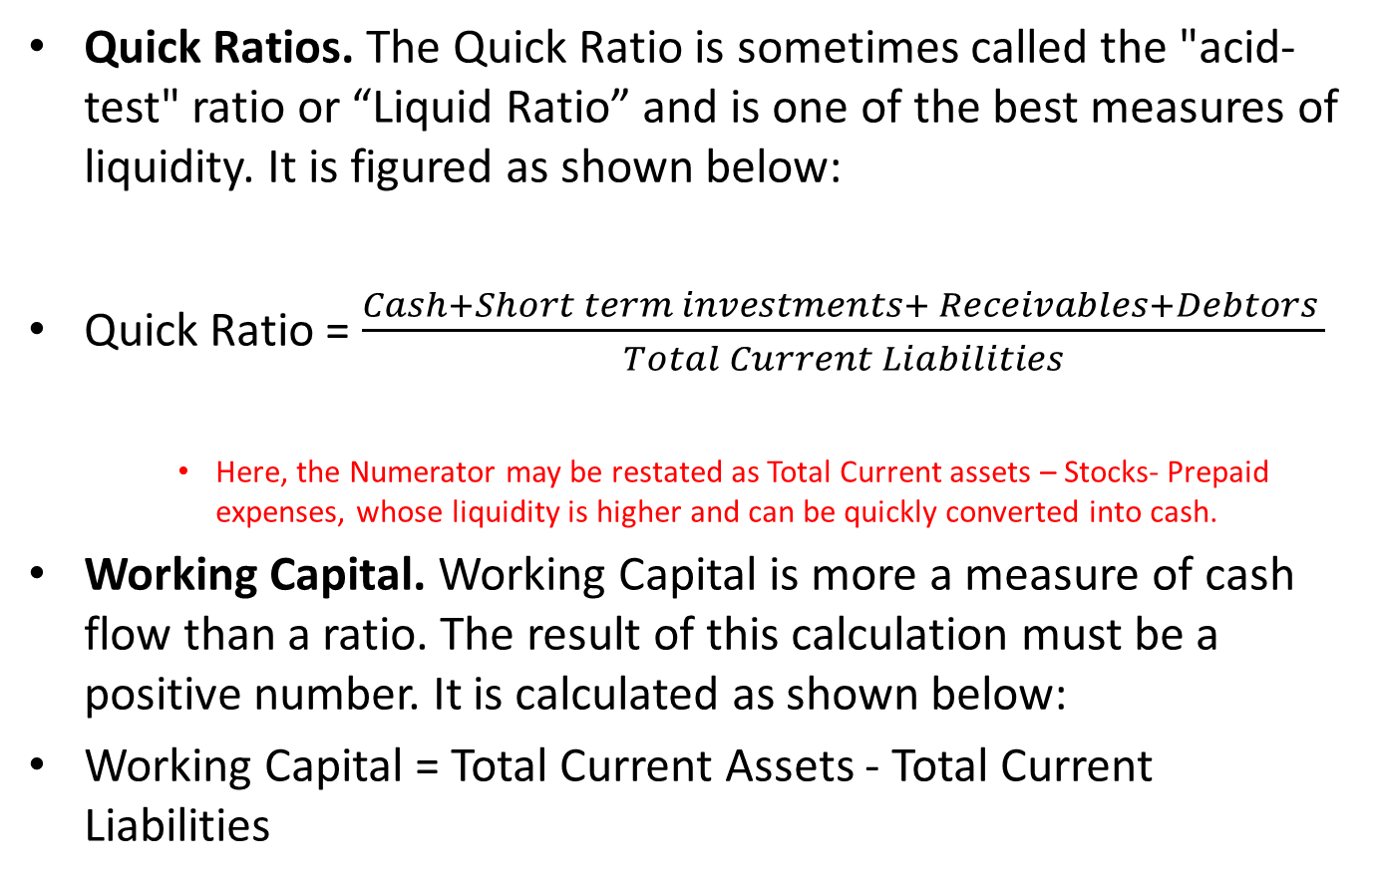
Financial Ratios
Quick Ratios. The Quick Ratio is sometimes called the "acid-test" ratio or “Liquid Ratio” and is one of the best measures of liquidity. It is figured as shown below:
Quick Ratio = $\frac{Cash+Short term investments+ Receivables+Debtors }{Total Current Liabilities}$
Here, the Numerator may be restated as Total Current assets – Stocks- Prepaid expenses, whose liquidity is higher and can be quickly converted into cash.
Working Capital. Working Capital is more a measure of cash flow than a ratio. The result of this calculation must be a positive number. It is calculated as shown below:
Working Capital = Total Current Assets - Total Current Liabilities

Slide 20
Debt-Equity Ratio
It is the relationship between borrower’s fund (Debt) and Owner’s Capital (Equity).
Long Term Outside Liabilities / Tangible Net Worth
Liabilities of Long Term Nature
Total of Capital and Reserves & Surplus Less Intangible Assets, if any.
For instance, if the Firm is having the following :
Capital = Rs. 200 Lacs
Free Reserves & Surplus = Rs. 300 Lacs
Long Term Loans/Liabilities = Rs. 800 Lacs
Debt Equity Ratio will be => 800/500 i.e. 1.6 : 1

Slide 21

Debt-Equity Ratio
Debt-Equity Ratio =$\frac{Total Long term Debts}{Shareholders^{′}Funds}$
Shareholders’ funds to include Equity Share capital, P&L A/C –Credit Balance as P&L Reserve and General Reserves and Surplus
From the Shareholders’ Funds deductions should be made for P&L Debit Balance/ Fictitious Assets.
Problem Sum
10,000 Equity shares @ $10 each. | 1,00,000
General reserve | 45,000
Accumulated profit | 30,000
Debentures | 75,000
Sundry trade creditors | 40,000
Outstanding expenses | 10,000
Solution:
Debt-Equity Ratio = Total long term debts / Shareholders funds
= 75,000 / 1,00,000 + 45,000 + 30,000 = 3 : 7
Every three dollars of long-term debts are being backed by an investment of seven
dollars by the owners. Thus the safety margin for creditors is more than double.

Slide 22
Problem sum on Ratio Analysis
LIABILITIES |  | ASSETS
Capital | 300 | Plant & Equipment | 65
General Reserves | 55 | Land & Building | 200
P & L Credit Balance | 7 | Cash | 1
Loan From S F C | 65 | Bills Receivables | 100
Debentures | 35 | Government Bonds | 25
Bank Overdraft | 38 | Stocks | 128
Sundry Creditors | 26 | Prepaid Expenses | 1
Provision of Tax | 9 | Goodwill | 30
Proposed Dividend | 15
 | 550 |  | 550

Slide 23
Answer
What is the Current Ratio ?
Ans : (125 +128+1+1) / (38+26+9+15)
= 255/88
= 2.89 : 1
Q What is the Quick Ratio ? Ans : (125+1)/ 88 = 1.43 : 1
Q. What is the Debt Equity Ratio ? Ans : LTL / Tangible NW
= 100 / ( 362 – 30)
= 100 / 332 = 0.30 : 1

Slide 24

Other Ratios
Debt Ratio= $\frac{Total Debts }{Total Assets}$
Debt Ratio shows the overall Debt burden of the company.
It is a financial ratio that indicates the percentage of a Company’s Assets that are provided via Debt.
It is the ratio of total debt (Long term Liabilities) and Total Assets (the sum of Current Assets, Fixed Assets, and other assets such as Goodwill). Here Outstanding expenses are normally excluded from the Outside Liabilities.
Example : Calculate debt ratio for PQR, Inc. based on the information given below
Current assets | 500,000
Non-current assets | 845,000
Non-current liabilities | 340,000
Current liabilities | 270,000
Accounts payable | 20,000
:Solution
Total assets = $500,000 + $845,000 = $1,345,000
Total debt = $340,000 + ($270,000 – $20,000) = $590,000
Please note that we excluded accounts payable from total liabilities because it is a liability but not debt funded by Creditors.

Slide 25

Inventory Turnover Ratio
Inventory Turn Over Ratio=$\frac{Cost of Goods sold}{Average Inventories (Average of Opening and Closing Stock)}$
Cost of Goods sold= Opening stock+ Cost of Goods Manufactured - Closing stock
Example: Calculate inventory turnover and days inventories outstanding for ABC, Inc. based on the information given below:
Opening inventories | $25,000
Closing inventories | $30,000
Cost of goods manufactured | $245,000
Solution
Cost of goods sold = $25,000 + $245,000 – $30,000 = $240,000
Average inventories = ($25,000 + $30,000) ÷ 2 = $27,500
Inventory turnover ratio = $240,000 ÷ $27,500 = 8.73
Days inventories outstanding = 365 ÷ 8.73 = 41.8 days

Slide 26
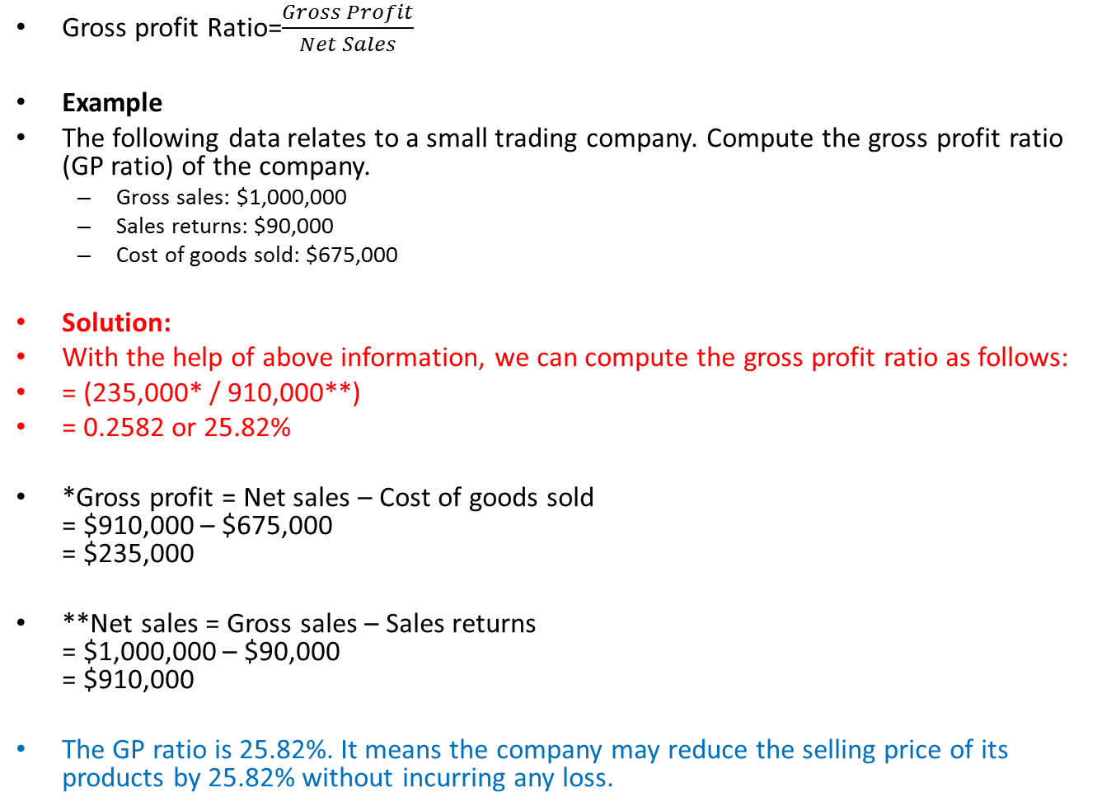
Gross Profit Ratio
Gross profit Ratio=$\frac{Gross Profit}{Net Sales}$
Example
The following data relates to a small trading company. Compute the gross profit ratio (GP ratio) of the company.
Gross sales: $1,000,000
Sales returns: $90,000
Cost of goods sold: $675,000
Solution:
With the help of above information, we can compute the gross profit ratio as follows:
= (235,000* / 910,000**)
= 0.2582 or 25.82%
*Gross profit = Net sales – Cost of goods sold = $910,000 – $675,000 = $235,000
**Net sales = Gross sales – Sales returns = $1,000,000 – $90,000 = $910,000
The GP ratio is 25.82%. It means the company may reduce the selling price of its products by 25.82% without incurring any loss.

Slide 27
Operating Profit Ratio
The Operating Profit Ratio is calculated by dividing the operating income by the net sales during a period. ...
Operating income can be calculated by subtracting operating expenses, depreciation, and amortization from gross income or revenues.
Operating profit = Gross profit - Operating Expenses
OR
Operating profit = Net sales - Operating cost
OR
= Net sales - (Cost of goods sold + Administrative and
office expenses + Selling and distribution exp.)
OR
(Net profit + Non-operating expenses) - (Non-operating incomes)

Slide 28
Example
Particulars | $ | Particulars | $
Sales less returns | 4,00,000 | Selling expenses | 25,000
Gross profit | 1,40,000 | Income from investment | 1,000
Administration expenses | 35,000 | Loss on account of fire | 2,000
:
Solution:
Operating profit = Gross profit - Administration and selling expenses
= 1,40,000 - (35,000 + 25,000)
= 1,40,000 - 60,000
= $80,000
Operating profit ratio = (80, 000 / 4,00,000) × 100
= 20 %

Slide 29
Additional Questions
Item of the Balance Sheet Rs.
Cash 10,000
Accounts Receivables 30,000
Inventory 80,000
Prepaid Insurance 6,000
Long-term Assets 200,000
Accounts Payable 30,000
Notes payable due in 10 months 25,000
Wages payable 5,000
Long-term Liabilities 70,000
Owner’s Equity 196,000
Determine
Quick Ratio
Debt-Equity Ratio
Debt Ratio
Working Capital

Slide 30
Practice Problem Sums
Company’s last year sales (all on Credit) of R. 830,000and Cost of Goods sold is Rs.525,000
At the beginning of the year its Accounts Receivables were Rs. 80,000 and its Inventory was Rs. 100,000.
At the end of the year its Accounts Receivable were Rs. 86,000 and Inventory was 110,000.
Find Inventory Turn over Ratio and Gross Profit Ratio

Slide 31
Forecasting
Methods and Tools

Slide 32
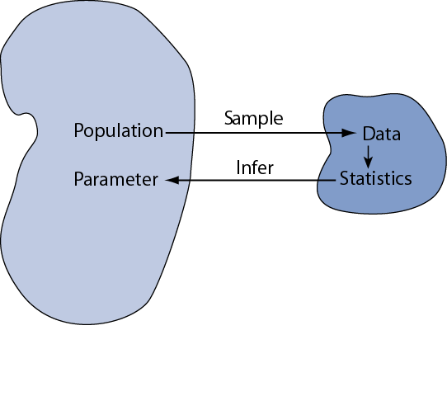
Statistical inference
Statistical inference:
Drawing conclusions about the whole population on the basis of a sample
Precondition for statistical inference:
A sample is randomly selected from the population (=probability sample)
We want to learn about population parameters…
…but we can only calculate sample statistics

Slide 33
Parameters and Statistics
We are going to illustrate inferential concept by considering how well a given sample mean reflects an underling population mean µ
µ

Slide 34
Key Relations between Population and Samples
Relation 1 (central limit theorem): the sampling distribution of tends toward Normality even when the population is not Normal (esp. strong in large samples).
Relation 2 (unbiasedness): the expected value of is μ
Relation 3 is related to the square root law, which says:
Again, the square root law says:
Notes:
This slide summarizes three major facts about SDMs (sampling distribution of a mean, abbreviated as SDM).
The standard deviation of the sampling distribution of the mean has a special name: standard error of the mean (denoted σ_{xbar} or SE_{xbar})

Slide 35
Forecasting
An essential aspect of managing any organization is planning for the future.
Organizations employ forecasting techniques to determine future inventory, costs, capacities, and interest rate changes.
There are two basic approaches to forecasting:
-Qualitative
-Quantitative

Slide 36
Qualitative Approach to Forecasting
Delphi Method
A panel of experts, each of whom is physically separated from the others and is anonymous, is asked to respond to a sequential series of questionnaires.
After each questionnaire, the responses are tabulated and the information and opinions of the entire group and the central value are made known to each of the other panel members so that they may revise their previous forecast response.
The process continues until some degree of consensus is achieved.

Slide 37
Quantitative Method
Time Series Data
Time Series Data is usually plotted on a graph to determine the various characteristics or components of the time series data.
There are 4 Major Components:
Trend,
Cyclical,
Seasonal, and
Irregular Components.

Slide 38
Components of a Time Series
The trend component accounts for the gradual shifting of the time series over a long period of time.
Any regular pattern of sequences of values above and below the trend line is attributable to the cyclical component of the series.
The seasonal component of the series accounts for regular patterns of variability within certain time periods, such as over a year.
The irregular component of the series is caused by short-term, unanticipated and non-recurring factors that affect the values of the time series. One cannot attempt to predict its impact on the time series in advance.

Slide 39
Measures of Forecast Accuracy
Mean Squared Error (MSE)
The average of the squared forecast errors for the historical data is calculated. The forecasting method or parameter(s) which minimize this mean squared error is then selected.
Mean Absolute Deviation (MAD)
The mean of the absolute values of all forecast errors is calculated, and the forecasting method or parameter(s) which minimize this measure is selected. The mean absolute deviation measure is less sensitive to individual large forecast errors than the mean squared error measure.
You may choose either of the above criteria for evaluating the accuracy of a method (or parameter).

Slide 40
Trend Projection
If a time series exhibits a linear trend, the method of least squares method may be used to determine a trend line (projection) for future forecasts.
Least squares, also used in regression analysis, determines the unique trend line forecast which minimizes the mean square error between the trend line forecasts and the actual observed values for the time series.
Example: The independent variable is the time period and the dependent variable is the actual observed value in the time series.

Slide 41
Trend Projection
Using the method of least squares, the formula for the trend projection is:
Y_{t} = b₀ + b₁t.
where: Y_{t} = trend forecast for time period t
b₁ = slope of the trend line
b₀ = trend line projection for time 0 (i.e. constant part)
nΣ tY_{t} - Σt ΣY_{t}
nΣt ² - (Σt )²
And,
where: Y_{t} = observed value of the time series at time period t
= average of the observed values for Y_{t}
= average time period for the n observations
b₁ =

Slide 42
Example: Plumbing Service
The number of plumbing repair jobs performed by a Plumbing Service in each of the last nine months are listed below.
Month Jobs Month Jobs Month Jobs
March 353 June 374 September 399
April 387 July 396 October 412
May 342 August 409 November 408
Forecast the number of repair jobs the Plumber will perform in December using the least squares method.

Slide 43
Plumbing Service: Trend Projection
Trend Projection
(month) t Y_{t} tY_{t} t ²
(Mar.) 1 353 353 1
(Apr.) 2 387 774 4
(May) 3 342 1026 9
(June) 4 374 1496 16
(July) 5 396 1980 25
(Aug.) 6 409 2454 36
(Sep.) 7 399 2793 49
(Oct.) 8 412 3296 64
(Nov.) 9 408 3672 81
Sum 45 3480 17844 285

Slide 44
Example: Plumbing Service
Trend Projection (continued)
= 45/9 = 5 = 3480/9 = 386.667
nΣtY_{t} - Σ t Σ Y_{t} (9)(17844) - (45)(3480)
b₁ = = = 7.4
n Σ t ² - (Σ t)² (9)(285) - (45)²
= 386.667 - 7.4(5) = 349.667
Thus our trend line is Y_{t} = 349.667 + 7.4 t.
Y₁₀ = 349.667 + (7.4)(10) =
423.667
For December t=10

Slide 45
Regression Analysis
Regression Analysis is similar to trend analysis, except the independent variable is not restricted to time.
For this model, we can find the regression equation in the same manner in which we have found the trend line except we would call the independent variable x, instead of t.
Regression analysis is used to indicate the cause-and-effect relationship between X and Y, that is a change in the value of independent variable X causes a corresponding change (effect) in the value of dependent variable Y if all other factors that affect Y remain unchanged.
Correlation analysis, in contrast, assures the existence of an association between two variables X and Y but not that they have a cause and effect relationship.

Slide 46
Regression Equation
Using the method of least squares, the formula for the regression line is:
Y = b₀ + b₁x.
where: Y= dependent variable which depends on the value of x
b₁ = slope of the regression line
b₀ = regression line projection for x= 0 ( i.e. Constant value)
nΣ X_{i}Y_{i} - ΣX_{i} ΣY_{i}
nΣX_{i}² - (ΣX_{i})²
where: Y = observed value of the independent variable X
= average of the observed values for Y
x­ˉ = average of independent variable for the n observations
Here, b₁ =
i
i
i

Slide 47
Example: Regression Analysis
Estimate the increase in sales revenue expected from an increase of 7.5 percent in advertising expenditure
Firm | Annual pc increase in Advertising expenditure | Annual pc increase in Sales revenue
A | 1 | 1
B | 3 | 2
C | 4 | 2
D | 6 | 4
E | 8 | 6
F | 9 | 8
G | 11 | 8
H | 14 | 9

Slide 48
Solution: Here, Sales revenue (Y) is dependent on advertising expenditure (X). Calculation for Regression Equation
Sales Revenue (Y) | Advertising Expenditure (X) | X² | XY
1 | 1 | 1 | 1
2 | 3 | 9 | 6
2 | 4 | 16 | 8
4 | 6 | 36 | 24
6 | 8 | 64 | 48
8 | 11 | 121 | 88
9 | 14 | 196 | 126
40 | 56 | 524 | 373
nΣ X_{i}Y_{i} - ΣX_{i} ΣY_{i}
8x 373- 40x56 2984- 2240 744
Here, b₁ =
= --------------------- = ------------------- = --------- = 0.704
nΣX_{i}² - (ΣX_{i})²
8x524 – (56)² 4192- 3136 1056
Or, bo = 5- 0.704 x 7 = 0.072;
Hence, Regression equation is Y = 0.072 + 0.704 X
Value of Y for X = 0.075 is 12.48%

Slide 49
SQC
Statistical Quality Control

Slide 50
Introduction to SQC
Talking about solving quality problems is not enough. We need specific tools that can help us make the right quality decisions.–
These tools come from the area of statistics and are used to help identify quality problems in the production process as well as in the product itself.
Statistical quality control (SQC) is the term used to describe the set of statistical tools used for measuring the quality performance, for acceptance/rejection decisions and to initiate CA/PA by quality professionals.

Slide 51
Sample represents Population
Statistical method is used for determining the extent to which quality goals are being met without necessarily checking every item produced.
This also helps in indicating whether or not the variations which occur in the conversion process are exceeding the limits of tolerances allowed by the customer and
This provides early warning for CA/PA
Thus it helps us to decide whether to reject or accept a particular product.
And ensure that the products produced are meeting customer needs.

Slide 52
SQC- Types of Variations
Statistical quality control exercise begins with the assumptions that no two products manufactured by a process are absolutely identical.
If variability is inevitable in any product or process, then how much of the variation is unavoidable? This raises the need for quality control.
The causes of variation in the quality of products or services from standards can be divided into the following two categories
Chance or common causes of variation
They are inherent to the process and cannot be reduced or eliminated without modification in the process itself. When the variability present in a process is confined to chance variation, the process is said to be in a state of statistical control.
Assignable causes of variation
The variation may be due to non-random causes. This may be due to the abnormality in the input material, or may be abnormality in the manufacturing processes, caused by the inefficiency of the operator or the machine.

Slide 53
Three SQC Categories
SQC can be divided into three broad categories:
Descriptive statistics
Descriptive statistics are used to describe quality characteristics and relationships.
e.g. the mean, standard deviation, and range
Acceptance Sampling
Acceptance sampling is the process of randomly inspecting a sample of goods and deciding whether to accept or reject the entire lot based on the results.
Does not help to catch in-process problems
Statistical process control (SPC)
Involves inspecting the output from a process
Quality characteristics are measured and charted
Helpful in identifying in-process variations and taking corrective actions

Slide 54
Use of the Three
Descriptive Statistics
Descriptive statistics are used to describe certain quality characteristics, such as the central tendency and variability of observed data. Although descriptions of certain characteristics are helpful, they are not enough to help us evaluate whether there is a problem of unacceptable quality with the lot.

Slide 55
Measure of Central tendency
A measure of central tendency is a single number used to represent the centre of the Grouped Data.
Different variables may possess different numerical characteristics. So different measures of Central Tendency is required.
Mode
Median
Mean
This class of measures can be for group or ungrouped data.

Slide 56
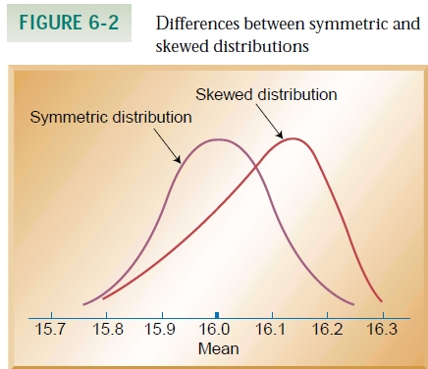
The Mode
The Mode is the most frequently occurring value in a group of raw scores.

Slide 57
The Median
The Median is defined as the middle value (of cases) of n values of X objects arranged in order of size
For odd no of cases the Middle Value will be (n+1)/2.
For even no of cases the Middle Value will be half way between the n/2 and (n+1)/2.

Slide 58
The Mean
x1+x2+x3+….. + xn
For Samples : X̅ = -------------------------------------
n
X1+X2+X3…………XN
For populations : μ= ----------------------------
N

Slide 59
Use of the Three
Acceptance Sampling
Descriptive Statistics does not help us in deciding whether a group of data is acceptable or not.
Acceptance sampling can help us to do this. Acceptance sampling helps us to decide whether desirable quality has been achieved for a batch of products, and whether to accept or reject the items produced.

Slide 60
Usefulness of Acceptance Sampling
Acceptance sampling is very useful when
Large no of items are processed in a short time
The cost of passing defective is low
Fatigue and boredom is caused by large no of items inspection.
Destructive testing is required

Slide 61
RISK
RISKS for the producer and consumer in sampling plans:
Acceptable Quality Level (AQL)
Max. acceptable percentage of defectives defined by producer.
α (Producer’s risk)
The probability of rejecting a good lot.
Lot Tolerance Percent Defective (LTPD)
Percentage of defectives that defines consumer’s rejection point.
β (Consumer’s risk)
The probability of accepting a bad lot.

Slide 62
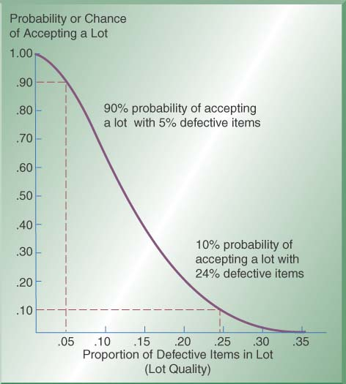
Operating Characteristics (OC) Curves
Operating Characteristic (OC) Curve: This curve plots the probability of accepting the lot (Y-axis) versus the lot fraction or percent defectives (X-axis). The OC curve is the primary tool for displaying and investigating the properties of a LASP (Lot Acceptance Sampling Plan).
X-axis shows % of items that are defective in a lot- “lot quality”
Y-axis shows the probability or chance of accepting a lot
As proportion of defects increases, the chance of accepting lot decreases
Example: 90% chance of accepting a lot with 5% defectives; 10% chance of accepting a lot with 24% defectives

Slide 63
Introducing Statistical Process Control
A manufacturing process when in a statistical control also provides the limits of its natural variation, which may be calculated with the help of Statistical tools. Such limits are drawn for process control at the shop floor level and are known as Control Charts.
Abnormality in the process causes variations in the products which are not acceptable by the customer and can be tracked with the help of the above Control Charts during the manufacturing process.
Information received by plotting observed quality data on the Control Charts can be used to control the process and produce goods within the acceptable quality standards. This is known as Statistical Process Control.

Slide 64
Control Charts
Control Charts are graphs that establish control limits of a process
Control limits
upper and lower bands of a control chart
Types of charts
Variables
range (R-chart)
mean (x̅ – chart)
Attributes
p-chart
c-chart

Slide 65
Control Charts
Control Charts provide a basis of monitoring variations in the predetermined quality of a product or process.
The use of control charts help to
Focus on the time dimension in which a system produces products or services
Identify the nature of variation in the process during operation and
Ensure that only acceptable products or services are produced by monitoring the process average, which is expected to stay within the bounds of upper and lower statistical limits.
Whenever an out-of control situation is detected, corrective action will be taken to bring the process back into control.
A Control Chart is essentially a graphic device for presenting data so as to identify the frequency and extent of variations from established standards.

Slide 66
Control Charts by Variables
Control Charts by variables are the followings
The Average Chart (X̅- Chart), which assumes the central tendency of the process
The Range Chart (R-chart), which measures the spread of the process
Since the Average Chart and Range Charts are usually used together , they are commonly known as (X̅-R) chart.

Slide 67
Theory underlying X̅-R Chart
Average of a sample of several items tend to cancel out the normal process variations and Undesirable changes due to assignable causes thereafter become visible.
Statistical limits of the X̅-R chart are based on the concept-
The Arithmetic Means of samples are distributed according to normal distribution with sample mean X̿, which is equal to mean of the population μ and Standard Deviation of sample means σ x̅ equal to √σ/n, where σ is the standard deviation of the Population and n is the sample size.

Slide 68
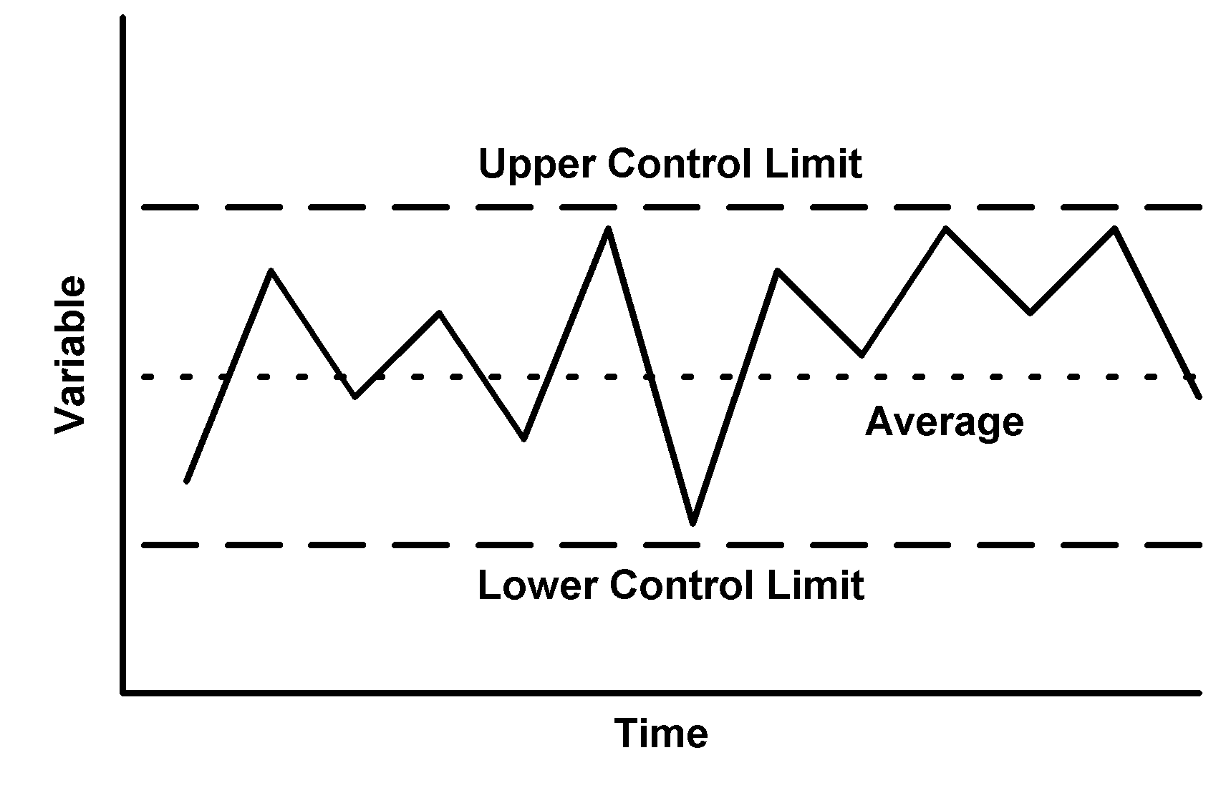
Control Chart
A Control Chart consists of three horizontal lines called Control limits which are within +/- 3 Standard Deviation of the Statistical measures
Upper Control Limit (UCL) indicates the upper limits of the tolerance
Lowe Control limits (LCL) indicating the lower limit of the tolerance.
Average or Central line should be the designed mean .
If all the product measures are found to be between the upper and lower control limits, it is assumed that the process is “in Control” and only chance causes are present.

Slide 69
Setting Up of Control Chart Using X̄ -R Chart
The Construction of an X̄ Chart is based on the Central Limit Theorem. This states that
Regardless of the population of all parts of services, the distribution of X̄ s (each of which
is the mean of a sample drawn from the population) will tend to follow a normal curve
as the sample size increases, where
The mean of population = μ
= sample mean
And Standard Deviation of sample
means σ x̅ equal to √σ/n, where σ is
the standard deviation of the Population
and n is the sample size.
Control Charts can be recalculated as
Where, A2, D3, D4 are Statistical Constants

Slide 70
Steps to follow in making X̅- R Chart
For X̅ Chart
Step-1 :- Calculate Sample Mean (X̅) and Sample Range (R) of each sample lot
Step-2 :- Calculate total Population average and the Mean Range (X̿ and R̅ )
Step-3 :- Set up a X̅ Control Chart for the Average from X̿ + A2 R̅ for UCLx̅ and X̿ - A2 R̅ for LCLx̅
For R-Chart
Step-4 :-Calculate Control Limits for the Range Chart by using UCLR as D4R̅ and LCLR as D3R̅
Step-5:- Set up a Range Chart and comment with both X̅ and R chart.

Slide 71
Problem Sum
A line inspector in an engineering company recorded dimensions of each of the 5 jobs selected at the end of every half an hour of the 5 hours in the shift. The design specifications are 25.0 +/- 0.10.
Plot X̅-R chart and find out which of the given observations are out of control. Given- A2= 0.5768, D3 =0, D4= 2.114
Sample Individual Measurements No. 1 2 3 4 5
1 25.00 25.01 25.00 25.03 25.01
2. 25.00 25.03 25.00 25.04 25.03
3. 25.01 25.02 25.02 25.03 25.02
4. 25.01 25.02 25.02 25.01 25.04
5. 25.02 25.02 25.03 25.03 25.00
6. 25.06 25.03 25.02 25.00 24.99
7. 24.99 24.98 25.02 25.02 24.99
8. 25.02 25.01 25.01 24.99 25.02
9. 25.03 25.01 24.97 25.01 25.03
10. 25.02 24.99 24.99 24.98 24.97

Slide 72
Computations: -
Sample No. | Individual Measurements 1 2 3 4 5 |  |  |  |  | X̄ | R
1 | 25.00 | 25.01 | 25.00 | 25.03 | 25.01 | 25.01 | 0.03
2 | 25.00 | 25.03 | 25.00 | 25.04 | 25.03 | 25.02 | 0.04
3 | 25.01 | 25.02 | 25.02 | 25.03 | 25.02 | 25.02 | 0.02
4 | 25.01 | 25.02 | 25.02 | 25.01 | 25.04 | 25.02 | 0.03
5 | 25.02 | 25.02 | 25.03 | 25.03 | 25.00 | 25.02 | 0.03
6 | 25.06 | 25.03 | 25.02 | 25.00 | 24.99 | 25.02 | 0.07
7 | 24.99 | 24.98 | 25.02 | 25.02 | 24.99 | 25.00 | 0.04
8 | 25.02 | 25.01 | 25.01 | 24.99 | 25.02 | 25.01 | 0.03
9 | 25.03 | 25.01 | 24.97 | 25.01 | 25.03 | 25.01 | 0.06
10 | 25.02 | 24.99 | 24.99 | 24.98 | 24.97 | 24.99 | 0.05
 |  |  |  |  |  | X̄̄ | R̄
 |  |  |  |  |  | 25.01 | 0.04

Slide 73
X̄ Chart
Diameter Measurement
UCL
CL
LCL
Sample N0.
Computations: - Central Line = CLx̄ = X̿ = 25.01 Upper Control Limit UCLx̄ = X̿ + A2R̄ = 25.01+ .5768X.04 = 25.03 Lower Control Limit LCLx̄ = X̿ - A2R̄ = 25.01- .5768X .04 = 24.99

Slide 74
R-Chart
UCL
Range Value
CL
LCL
Sample No.
Computation
CLR = 0.04
UCLR = D4xR̄ = 2.114x 0.04 = 0.085
LCLR = D3xR̄ = 0

Slide 75
Example: SPC for bottle filling…
Sample | Observation (x_{i}) |  |  |  |  | Average | Range (R)
1 | 11.90 | 11.92 | 12.09 | 11.91 | 12.01
2 | 12.03 | 12.03 | 11.92 | 11.97 | 12.07
3 | 11.92 | 12.02 | 11.93 | 12.01 | 12.07
4 | 11.96 | 12.06 | 12.00 | 11.91 | 11.98
5 | 11.95 | 12.10 | 12.03 | 12.07 | 12.00
6 | 11.99 | 11.98 | 11.94 | 12.06 | 12.06
7 | 12.00 | 12.04 | 11.92 | 12.00 | 12.07
8 | 12.02 | 12.06 | 11.94 | 12.07 | 12.00
9 | 12.01 | 12.06 | 11.94 | 11.91 | 11.94
10 | 11.92 | 12.05 | 11.92 | 12.09 | 12.07

Slide 76
SPC for bottle filling…
Calculate the average and the range for each sample…
Sample | Observation (x_{i}) |  |  |  |  | Average | Range (R)
1 | 11.90 | 11.92 | 12.09 | 11.91 | 12.01 | 11.97 | 0.19
2 | 12.03 | 12.03 | 11.92 | 11.97 | 12.07 | 12.00 | 0.15
3 | 11.92 | 12.02 | 11.93 | 12.01 | 12.07 | 11.99 | 0.15
4 | 11.96 | 12.06 | 12.00 | 11.91 | 11.98 | 11.98 | 0.15
5 | 11.95 | 12.10 | 12.03 | 12.07 | 12.00 | 12.03 | 0.15
6 | 11.99 | 11.98 | 11.94 | 12.06 | 12.06 | 12.01 | 0.12
7 | 12.00 | 12.04 | 11.92 | 12.00 | 12.07 | 12.01 | 0.15
8 | 12.02 | 12.06 | 11.94 | 12.07 | 12.00 | 12.02 | 0.13
9 | 12.01 | 12.06 | 11.94 | 11.91 | 11.94 | 11.97 | 0.15
10 | 11.92 | 12.05 | 11.92 | 12.09 | 12.07 | 12.01 | 0.17

Slide 77
Then…
is the average of the averages
is the average of the ranges

Slide 78
Finally…
Calculate the upper and lower control limits

Slide 79
The X Chart
UCL = 12.10
X = 12.00
LCL = 11.90

Slide 80
The R Chart
UCL = 0.32
R = 0.15
LCL = 0.00

Slide 81
The X/R Chart
UCL
X
What can you conclude?
LCL
UCL
The process is in control
R
LCL

Slide 82
Control Charts by Attributes
This form of inspection is where the items comprising the sample are classified into two factions :
Acceptable “ and
“Non-acceptable”.
Such an inspection is termed as “Inspection by attributes”. This includes
Quantitative measurements are not possible as with the inspection for damages, matching of color against a standard shades, presence of bars, etc.
Quantitative measurements consume too much time with the inspection of p.c.d. of drilled holes etc. ( uses GO or NOGO gauge)

Slide 83
Control Charts by Attributes
The Control Charts by Attributes are basically the followings.
The Fraction Defective Chart (p-Chart) which records the proportion of defective items in a sample
The Number Defective Chart (np-Chart) which records the number of defective items in a sample
The Defects Chart (C- Chart) which records the number of defects in a component/ product

Slide 84
Control chart for Fraction Defectives
The control charts for fraction defectives is used where the products manufactured in the shops or products received from vendors are inspected and classified as either accepted or rejected.
This two way classification naturally leads to a binomial description of the standard error of the mean.
The Fraction Defective Chart (p-Chart) which records the proportion of defective items in a sample
The Number Defective Chart (np-Chart) which records the number of defective items in a sample

Slide 85
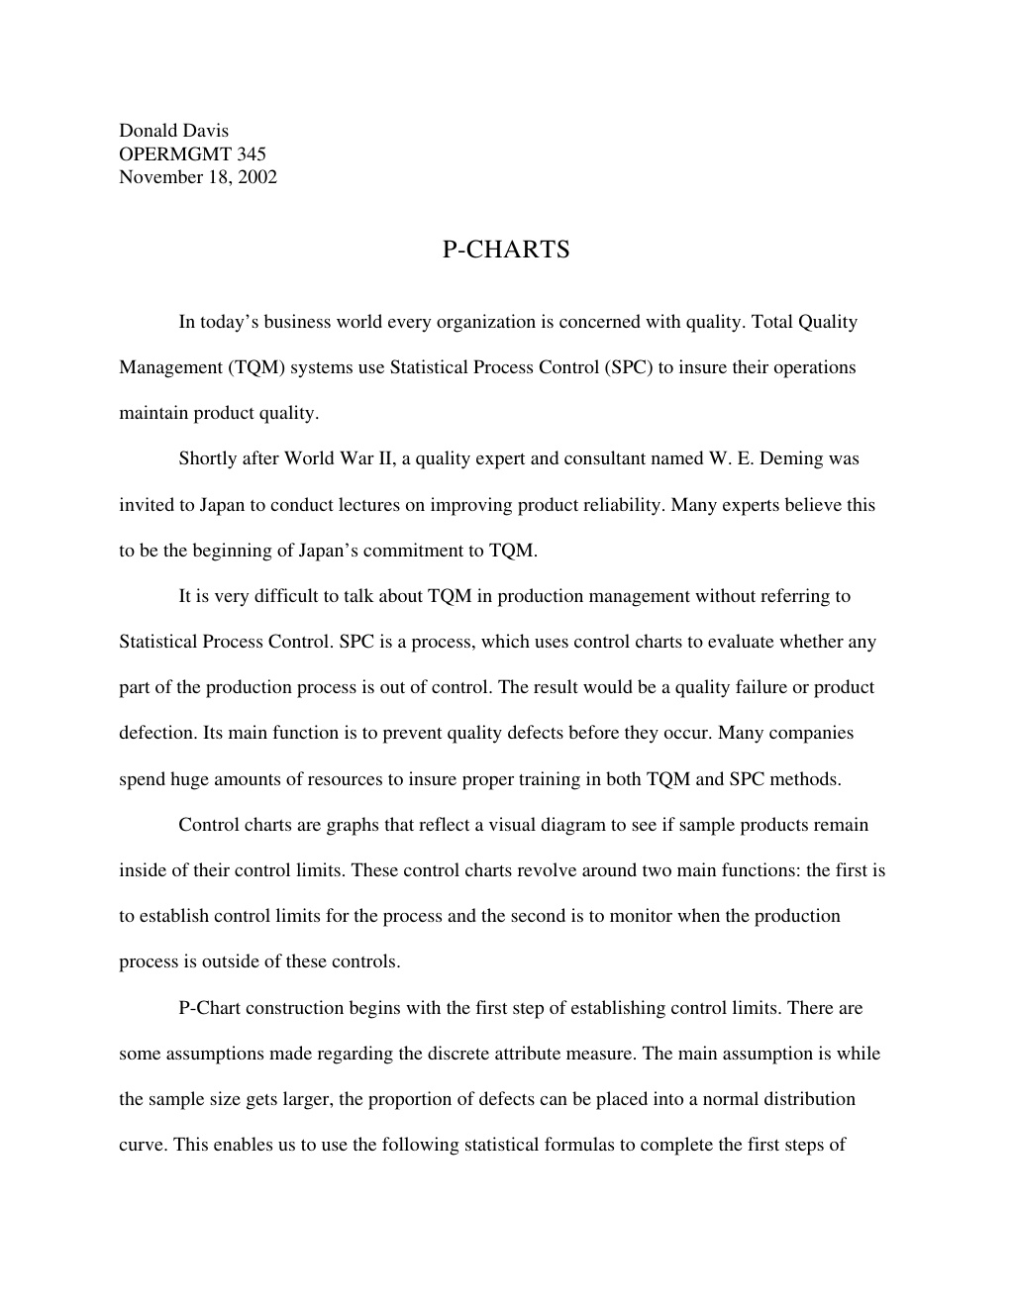

Slide 86
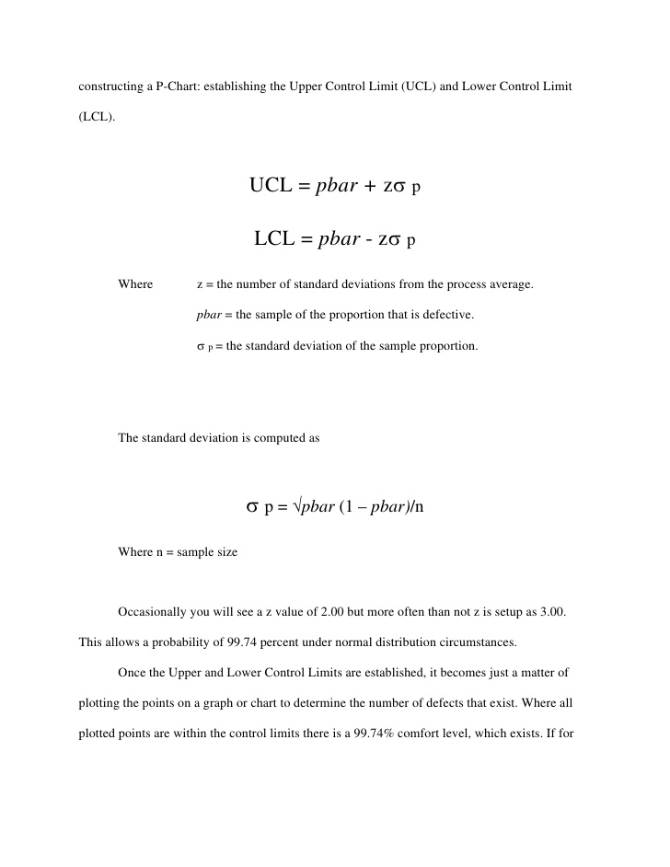
Z value can be 1.96 for 95% Confidence Interval.
More often than not, Z is set up as 3.0. This allows a probability of 99.74% under Normal Distribution.

Slide 87
Statistical Process Control with p Charts
When should we use p charts?
When decisions are simple “yes” or “no” by inspection
When the sample sizes are large enough (>50)
Sample (day) | Items | Defective | Percentage
1 | 200 | 10 | 0.050
2 | 200 | 8 | 0.040
3 | 200 | 9 | 0.045
4 | 200 | 13 | 0.065
5 | 200 | 15 | 0.075
6 | 200 | 25 | 0.125

Slide 88
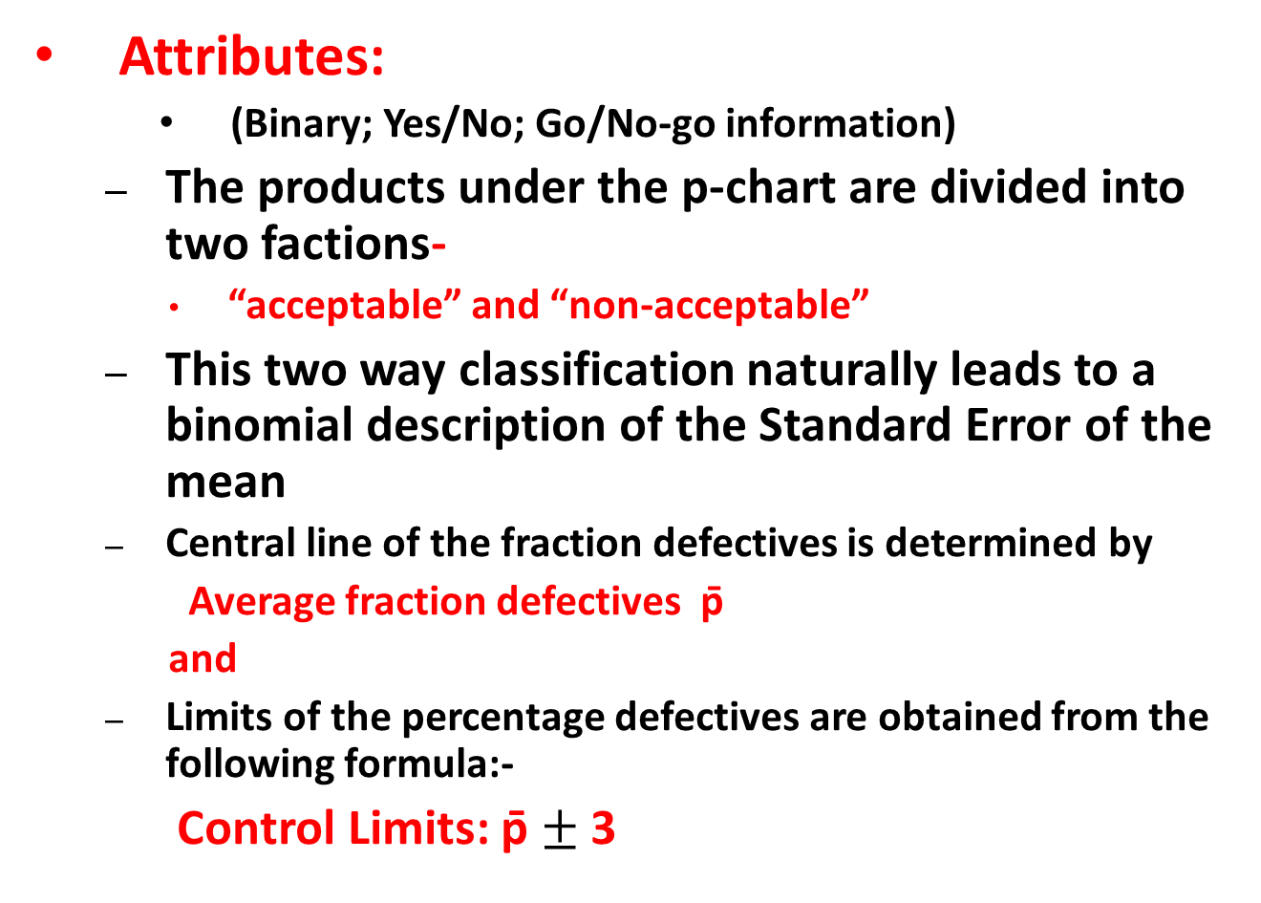
p-Chart
Attributes:
(Binary; Yes/No; Go/No-go information)
The products under the p-chart are divided into two factions-
“acceptable” and “non-acceptable”
This two way classification naturally leads to a binomial description of the Standard Error of the mean
Central line of the fraction defectives is determined by
Average fraction defectives p̄
and
Limits of the percentage defectives are obtained from the following formula:-
Control Limits: p̄ $±$3
-

Slide 89
Statistical Process Control with p Charts
Let’s assume that we take t samples of size n …

Slide 90
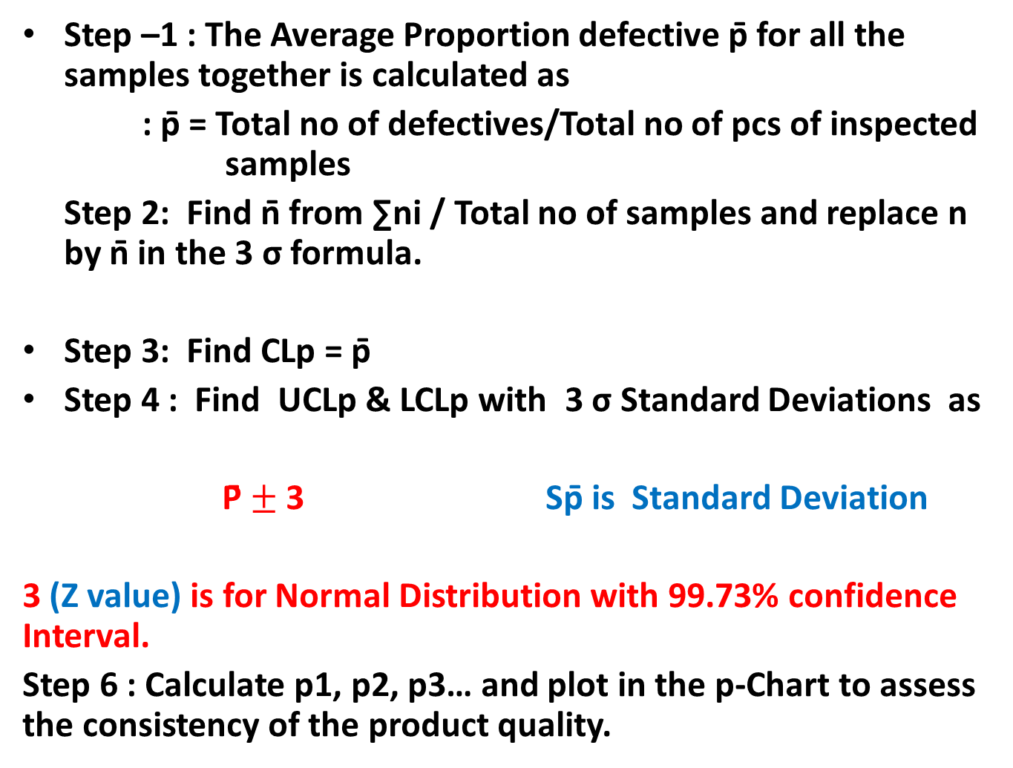
Steps to Construct p-Chart
Step –1 : The Average Proportion defective p̄ for all the samples together is calculated as
: p̄ = Total no of defectives/Total no of pcs of inspected samples
Step 2: Find n̄ from ∑ni / Total no of samples and replace n by n̄ in the 3 σ formula.
Step 3: Find CLp = p̄
Step 4 : Find UCLp & LCLp with 3 σ Standard Deviations as
P̄ $±$3 Sp̄ is Standard Deviation
3 (Z value) is for Normal Distribution with 99.73% confidence Interval.
Step 6 : Calculate p1, p2, p3… and plot in the p-Chart to assess the consistency of the product quality.
-

Slide 91
Statistical Process Control with p Charts

Slide 92
Statistical Process Control with p Charts
UCL = 0.117
p = 0.066
LCL = 0.015

Slide 93
Problem Example
Sample Number of No of item in each
Defective Sample
1 3 20
2 2 20
3 1 20
4 1 20
5 2 20

Slide 94

Computation of p-Chart
Sample No. | No of Defectives in each sample | No of items in each sample |  | Fraction Defective
1 | 3 | 20 |  | 0.15
2 | 2 | 20 |  | 0.1
3 | 1 | 20 |  | 0.05
4 | 1 | 20 |  | 0.05
5 | 2 | 20 |  | 0.1
Average Fraction Defective = p̄ = $\frac{Total No of Defective}{Total items inspected}$
= 9/100 = 0.09
Average no. per sample, n = 5x20/5= 20
Upper Control Limit = p̄ + 3 $√$p̄( 1-p̄)/n = 0.09 + 0.192 = 0.282
Lower Control Limit = p̄ - 3 $\sqrt{p}̄̄(1−p̄)/n$ = 0.09- 0.192
= -0.102=0
(Since the negative control limits are always taken as zero.)
-
-
--

Slide 95
Control Chart for Fraction Defective
UCL
CL
LCL
Sample No.

Slide 96
Problem Sum on p-chart
Six consecutive lots received from a vendor were inspected by sampling process In-coming Inspection of the buyer. Sample lot was varying as per the variation in the lot size. The inspection results are as follows :-
Construct a control chart for fraction defective and no of defectives.
Sample No | 1 | 2 | 3 | 4 | 5 | 6
Lot Size | 2850 | 1860 | 480 | 970 | 4385 | 2568
Sample Size | 125 | 125 | 50 | 80 | 200 | 125
No. of Defectives | 1 | 3 | - | 2 | 4 | 1

Slide 97
Solution
p̅ = Total No of defective items/ Total no. of items inspected
= (1+3+0+2+4+1)/125+125+50+80+200+125)=11/705= 0.016
Since the sample size is varying, find out avg. no. of pcs inspected n̅=705/6=117.5
Then UCLp= p̅+3 √ p̅(1- p̅)/n̅ =.016+3X0.0116= 0.051
LCLp=-0.019=0
np-chart
CLnp= n̅. p̅=0.016X117.5=1.88
UCLnp= n̅. p̅+ 3 √ n̅. p̅ (1- p̅)=1.88+3 √.016X117.5 (1.0X.016)=1.88+4.08=5.96
LCLnp= 1.88-4.08=0

Slide 98
Problem on p-Chart
Completed forms of a particular department of an insurance company were sampled daily to check the performance quality of the department. To establish a tentative norm for the department one sample of 100 units was collected each day for 15 days with these results.
Number of Forms |  |  | Number of Forms
Sample | Sample Size | With errors | Sample | Sample Size | With errors
1 | 100 | 4 | 9 | 100 | 4
2 | 100 | 3 | 10 | 100 | 2
3 | 100 | 5 | 11 | 100 | 7
4 | 100 | 0 | 12 | 100 | 2
5 | 100 | 2 | 13 | 100 | 1
6 | 100 | 8 | 14 | 100 | 3
7 | 100 | 1 | 15 | 100 | 1
8 | 100 | 3
Develop a p chart using a 95 percent confidence interval (1.96 Sp)
Plot the 15 samples collected
What comments you can make about the process?

Slide 99
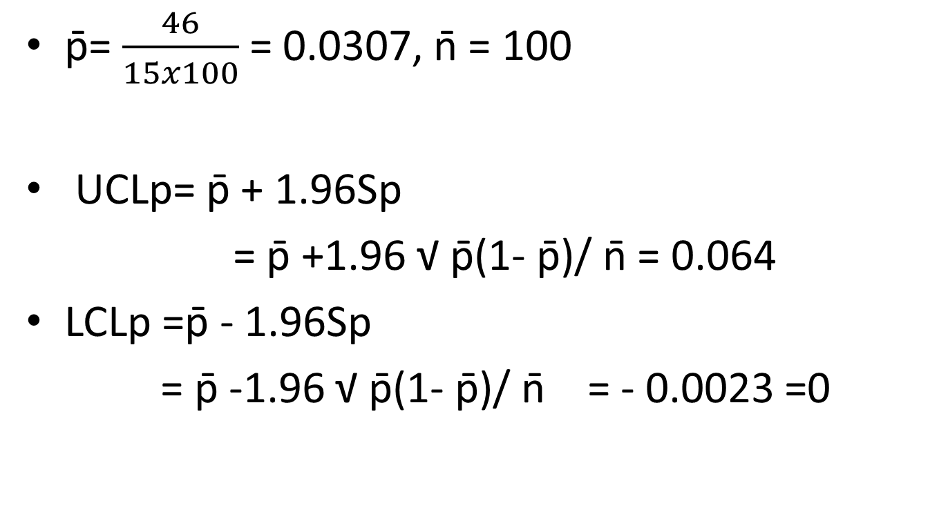
Solution
p̄= $\frac{46}{15x100}$ = 0.0307, n̄ = 100
UCLp= p̄ + 1.96Sp
= p̄ +1.96 √ p̄(1- p̄)/ n̄ = 0.064
LCLp =p̄ - 1.96Sp
= p̄ -1.96 √ p̄(1- p̄)/ n̄ = - 0.0023 =0

Slide 100
Control Chart
Proportion Defectives are plotted below
Of the 15 samples, 2 were out of Control limits. Because the control limits were established as 95 percent or 1 out of 20, we would say that the process is out of control.
It needs to be examined to find the cause of such wide spread variation.
UCL – 0.064
LCL=0.00

Slide 101
Problem Sums
Management is trying to decide whether Part A which is produced with a consistent 3 per cent defective rate, should be inspected.
If it is not inspected, the 3% defective will go through a product assembly phase and have to be replaced later.
If all Part A s are inspected, one third of the defectives will be found, thus raising the quality to 2% defectives.
Should the inspection be done, if the cost of inspection is Re. 0.01per unit and the cost replacing a defective in the final assembly is Rs. 4.00?
Suppose the cost of inspecting is Re 0.05 per unit rather than Re 0.01, will your answer change?

Slide 102
Answer
Should Part A be inspected?
0.03 defective with no inspection
0.02 defective with inspection
This problem can be solved by looking at the opportunity for 1% improvement.
Benefit = 0.01x (Rs. 4.00)= Re. 0.04
Cost of inspection= Re. 0.01
Therefore inspection will save Re. 0.03 per unit
A cost of Re.0.05 will be higher than the benefit of Re. 0.04 saved and hence not beneficial.

Slide 103
Defect Chart
The Defects Chart (C- Chart) which records the number of defects in a component/ product. The defects could occur at any spot but the probability of their occurrence at a particular spot is very small whereas the number of spots where the defects can occur are very large.
Such a situation is correctly described by Poission distribution with
Mean equal to average number of defects in all samples , say c̅. And
Standard deviation equal to √ c̅
Eg. Cloth is set by the number of imperfections in a given length.

Slide 104
Control Limits of c-Chart
Central Line , CLc = c̅
Since value of c can never be negative hence if the lower control limit (LCLc) works out to be negative, then it taken equal to zero.
Upper Control Limit, UCLc = c̅ +3√ c̅
Lower Control Limit LCLc = c̅ - 3√ c̅

Slide 105
Problem Sum on c-Chart
Ten woolen carpets were studied for total no. of defects in their texture. The details of the number of defects in each carpet are given below.
Carpet No. 1 2 3 4 5 6 7 8 9 10
No. of defects 2 4 3 5 1 3 2 3 4 3
All ten carpets are however were regarded as acceptable by the QC of the company. Construct a Control Chart for number of defects and comment.
Central Line-c̅ = Total no. of defects/ Number of carpets = 30/10 = 3
Upper Control Limit (UCLc) = c̅ + 3 √ c̅ = 3+ 3 √ 3= 3+5.2=8.2
Lower Control Limits (LCLc) = c̅ - 3 √ c̅ = 3 - 3 √ 3 = 3-5.2 = -2.2=0

Slide 106
Control Charts for No. of Defects
UCL
CL
No. of Defects
LCL
Sample No. (Carpet No.)

Slide 107
Process Capability Measures
A process is a unique combination of tools, materials, methods, and people engaged in producing a measurable output; for example a manufacturing line for machine parts.
All processes have inherent statistical variability which can be evaluated by statistical methods.
Process capability index or Process capability ratio is a statistical measure of process capability: the ability of a process to produce output within specification limits.

Slide 108
Process Capability Index Cp/C_{pk}
Cp and Cpk are the process capability indices.
Cp-Measures the variation.,
how close the measures readings.,
Cpk -Measures the central tendency.,
how close the measures readings to Nominal
Cpk is more widely used than Cp, since it takes into account the mean and the standard deviation in its calculation.

Slide 109

Production Function
Notes:
Each type of business or industrial activity, or simply any productive activity
(a productive activity is one that combines production factors with the objective of obtaining
a result in the form of goods or services) will have a different production function.

Slide 110
Cobb- Douglas Production Function
In economics, a Production Function represents the relationship between the output and the combination of factors, or inputs, used to obtain it.
Q=f(L,K)
Where: - Q is the quantity of products - L the quantity of labor applied to the production of Q, for example, hours of labor in a month. - K the hours of capital applied to the production of Q, for example, hours a machine has been working for the production of Q.
There can be other inputs, K and L are just examples.
The Cobb-Douglas production function is a particular form of the production function. It is widely used because it has many attractive characteristics, as we will see below.
The basic form of the Cobb-Douglas production function is as follows:
Q(L,K) = A L^β K^α
Where: - Q is the quantity of products. - L is the quantity of labor. - K is the quantity of capital. - A is a positive constant. - β and α are constants between 0 and 1.

Slide 111
Extension of Cobb-Douglas Production Function
The production function is the relationship that exists between the obtained output and the combination of factors used to obtain it.
Given the state of technology at any given moment in time, the production function shows us that the quantity of product Q that is obtainable by a business is a function of the quantities of
capital (K),
labor (L),
land (P) and
business initiative (H),
so that:
Q = f(K,L,P,H) ……..

Slide 112
Production Management
Production Management is defined as
Planning, implementation, and control of industrial production processes to ensure smooth and efficient operation.
Production management responsibilities include the traditional “five M's”: man, machine, method, material and money.
Managers are expected not only
to get the job done by the workforce
but also
to develop and maintain an efficient production process by building a learning organization,
where
environment is built for the employees to continuously learn and adapt new technologies, equipment and schedules.

Slide 113
Production to Operation Management
Production management which was formerly considered as manufacturing management only, now after inclusion of services into its scope, is broadly known as operations management.
The growth of service industry has brought with it the term operations management. It is a general term these days.
Operation Management deals with
managing resources
inputs:
machines, raw materials, human skills, etc.,
the conversion process, and
distribution of finished goods and services (outputs to the customers).

Slide 114
Systems approach to Management
Operation Management
Inputs
Conversion
Subsystem
Outputs
Control
Subsystem
Organization as a System receives Input, transforms it through a Process for Output, receives feed back from customer for improvements. either at Input stage or at conversion sub-system.

Slide 115
Functions of Production Management
Functions of Production and Operation Management are as follows:-
Planning
Planning conversion system
Operation strategies
Forecasting
Product and process choice
Operation capacity arrangement
Facility location planning
Layout planning
Schedule conversion system
Scheduling system in aggregate planning
Execution
Organizing for conversion
Job design , production/operation standards, works management
Executing as per plan
Implementing the plan efficiently and effectively
Controlling
Manage the deviation and improve
Review the process and product for continuous improvements
Material control
Inventory control
Material requirement planning
Managing for world class competition
Managing for quality
Quality control and analysis
Introduction of modern manufacturing system

Slide 116
Objectives of Production Management
Producing the right kind of goods and services that satisfies customer’s needs –Effectiveness objective
Maximizing output of goods and services with minimum resource inputs– Efficiency objective
Ensuring that goods and services produces that conform to quality needs of the customer
–Quality objective
Minimizing through put time –time required for conversions-by reducing delays waiting time, idle time etc.– Lead time objective
Minimizing cost of production-Cost objective
Maximizing utilization of machines, manpower, capital etc.– Capacity utilization objective

Slide 117
Types of Production Systems
On the basis of material flow characteristics the production system can be grouped into the following four categories
Mass Production or Flow line production system
Batch production system
Job shops
Unit manufacture or Project
Depending on the flow characteristics inside the system, the manufacturing system can be simple or complex to manage

Slide 118
Types of Production System
Job Shops: Small lots, low volume, general equipment, skilled workers, high-variety.
Ex: tool and die shop, veterinarian’s office
Batch Processing: Moderate volume and variety. Variety among batches but not inside.
Ex: paint production, Cake shop (Mio Amore)
Repetitive/Assembly: Semi-continuous, high volume of standardized items, limited variety.
Ex: auto plants (Maruti car manufacturing), cafeteria
Continuous Processing: Very high volume and no variety.
Ex: steel mill (SAIL), Indian Oil Refinery
Projects: Non-routine jobs.
Ex: AJC Bose Road Flyover

Slide 119
Product – Process Matrix
Dimension | Job Shop | Batch | Repetitive | Continuous
Job variety | Very High | Moderate | Low | Very low
Process flexibility | Very High | Moderate | Low | Very low
Unit cost | Very High | Moderate | Low | Very low
Volume of output | Very low | Low | High | Very high

Slide 120
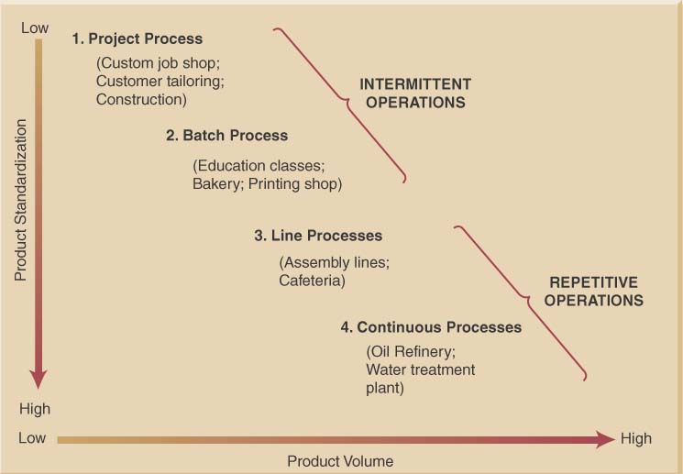
Product-Process Grid

Slide 121
Process Types
Process types can be:
Project process (Job Shops) – make a one-at-a-time product exactly to customer specifications
Batch process – small quantities of product in groups or batches based on customer orders or specifications
Line process (Repetitive Assembly)– large quantities of a standard product
Continuous process – very high volumes of a fully standard product
Process types exist on a continuum

Slide 122
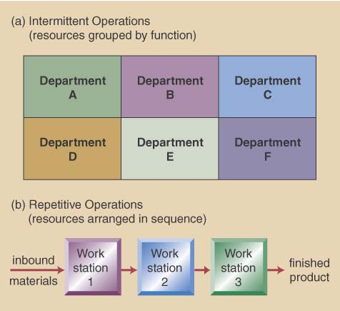
Intermittent VS. Repetitive Facility Layouts

Slide 123
Process Selection Considerations
Process selection is based on five principal considerations
Product-Process Grid
Degree of vertical integration
Flexibility of resources
Mix between capital & human resources
Degree of customer contact

Slide 124
Process Decisions-Vertical Integration & Make or Buy
Vertical integration refers to the degree a firm chooses to do processes itself- raw material to sales
Backward Integration means moving closer to primary operations
Forward Integration means moving closer to customers
A firm’s Make-or-Buy choices should be based on the following considerations:
Strategic impact
Available capacity
Expertise
Quality considerations
Speed
Cost (fixed cost + variable cost)make = Cost (fixed cost + Variable cost)buy
Business are trending toward less backward integration, more outsourcing

Slide 125
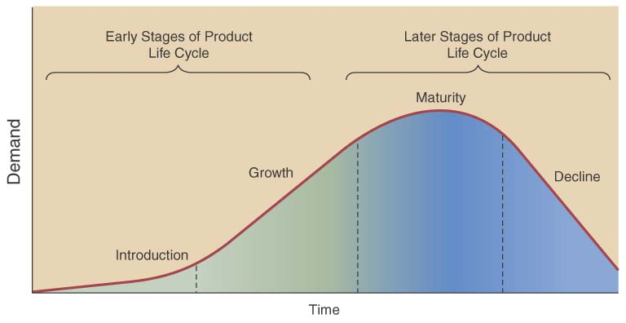
Product Life Cycle also affects decisions
Product life cycle – series of changing product demand
Consider product
life cycle stages
Introduction
Growth
Maturity
Decline
Facility & process investment depends on life cycle

Slide 126
Design of Services
Service design is unique in that the service and entire service concept are being designed
must define both the service and concept
- Physical elements, aesthetic & psychological benefits
e.g. promptness, friendliness, ambiance
Product and service design must match the needs and preferences of the targeted customer group

Slide 127
Designing Services vs Products
Services are different from manufacturing as they;
Produce intangible products
Involve a high degree of customer contact
Type of service is classified according to degree of customer contact

Slide 128
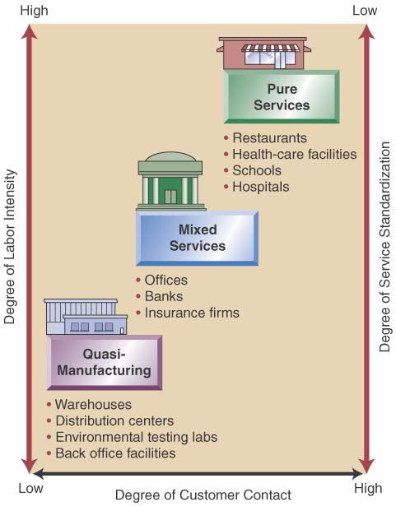
Service Design Matrix
Service Characteristics
Pure services
Quasi-Manufacturing
Mixed services
Service Package
The physical goods
The sensual benefits
The psychological benefits
Differing designs
Substitute technology for people
Get customer involved
High customer attention

Slide 129
Marketing
Sales & Marketing

Slide 130
What is Marketing?
Marketing identifies consumer’s needs and organizes business activities to satisfy these needs.
Marketing is the flow of products and services to consumers and the transactions that facilitate or manage that flow.
Thus it can be defined as an activity concerning
Planning, implementing, coordinating and controlling of all activities that concern demand stimulation (ie. Promotion and advertisement), demand estimating, pricing and distribution of products and services.
Marketing is managing profitable customer relationship.

Slide 131
Selling vs Marketing
Selling
Marketing
Selling focuses on needs of the seller
Selling is converting goods and services into cash
Selling is push
Selling concerns existing products and it undertakes the task of pushing the sale of existing products
Marketing focuses on the need of the buyer
Marketing includes creating, delivering and facilitating consumption.
Marketing is pull
Marketing concerns customers and undertake the task of identifying market needs and converting customer needs into products.

Slide 132
Selling vs Marketing
Selling
Marketing
Selling seeks profit by pushing the existing products on the customer
In selling the firms make the product first and push the product in the market
In selling cost determines the price
Marketing seeks profit by making the product and distribution system at an affordable price to create and meet the customer demand
Marketing first identifies the demand and then creates it
In marketing price determines the cost

Slide 133
Selling vs Marketing
Selling
Marketing
Selling looks at the customer as the last link in the business
Transportation , storage and warehousing are treated as mere extension of production functions
Profits through sales volume
Marketing looks at the customer as the very purpose of the business
Transportation, storage and warehousing are essential services to meet the customer expectations.
Profit through customer satisfaction

Slide 134
Marketing Mix & the 4Ps
The marketing mix and the 4 Ps of marketing are often used as synonyms for each other. In fact, they are not necessarily the same thing.
"Marketing mix" is a general phrase used to describe the different kinds of choices organizations have to make in the whole process of bringing a product or service to market.
The 4Ps is one way – probably the best-known way – of defining the marketing mix.
Basic components of a 4P Marketing mix are
Product
Place (and Time)
Price
Promotion
The marketing mix model of 4Ps can be used to decide how to take a new offer to market.
It can also be used to test the existing marketing strategy
Notes:
Amongst the other marketing mix models that have been developed and have become popular over the years is 7Ps.
This is sometimes called the extended marketing mix, which includes the first 4 Ps, plus people, processes and physical layout decisions.

Slide 135
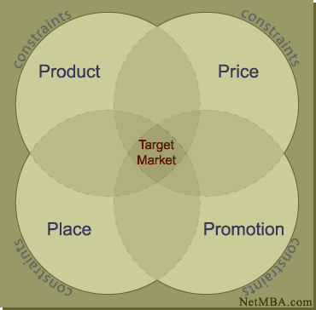
4Ps

Slide 136
4Ps
Product Marketing
What product/service(s) will I sell?
Product Includes branding and packaging and also the level of service (quality, dependability guarantees, etc.).
Product strategies may include concentrating on a
narrow product line, developing a highly specialized product or service, or
providing a product-service package containing unusually high quality service.
Some of the product strategies also include
Features-price trade-offs
Options and bundling
Kill your own products
(before competitors do)

Slide 137
4Ps
Place Marketing
Place (and Time) Method used to get the
product to target market i.e.
transportation,
marketing channel utilized,
market location.
Working through established distributors or
manufacturers' agents generally is easiest for small manufacturers. Small retailers consider cost and traffic flow in site selection, especially since advertising and rent can be reciprocal:
A low-cost, low-traffic location means spending more on advertising to build traffic.

Slide 138
4Ps
Price Marketing
The price of a product involves factors such as
cost of production,
competitors prices,
volume/ quality issues,
standard practices.
This also includes
Channel Pricing
Discounts
Terms etc.
The right price is crucial for maximizing total revenue. Generally, higher prices mean lower volume and vice-versa; however, small businesses can often command higher prices because of their personalized service.

Slide 139
4Ps
Promotion Marketing
• Promotion is communicating to customer about the product, place and price of the product.
Promotion strategies include advertising and direct customer interaction.
Good salesmanship is essential for small businesses because of their limited ability to spend on advertising.
Examples:
advertising
events
press releases
trade shows

Slide 140
Different Markets
Oligopoly
An oligopoly is a market structure in which a few firms dominate. When a market is shared between a few firms, it is said to be highly concentrated. Although only a few firms dominate, it is possible that many small firms may also operate in the market.
Internet Service Provider market with Jio, Airtel, Idea and Voda Phone dominate the market. The auto industry is another example of an oligopoly, with the leading auto manufacturers like Maruti Suzuki, Hyundai, Toyota leading the market.
Duopoly
A Duopoly is the most basic form of oligopoly, a market dominated by a small number of companies. A Duopoly can have the same impact on the market as a monopoly if the two players collude on prices or output.
Oligopsony
This typically happens in a market for inputs where numerous suppliers are competing to sell their product to a small number of (often large and powerful) buyers.

Slide 141
Short-Term Objectives of Marketing: SMART
Specific – The objective achieves a particular, detailed result.
Measurable – There is a means to determine the objective.
Attainable – They are within economic and physical capabilities.
Rewarding – They are profitable and self satisfying as an initiative.
Timed – They have a specific timeline and/or deadline.

Slide 142
Marketing Planning
A marketing plan helps a marketer to establish, direct and coordinate marketing efforts.
A company looks at itself and the world around it to create a marketing plan for reaching goals.
A marketing plan contains information about the company and its products, marketing objectives and strategies. It provides yardstick by which the success of a firm’s marketing activities can be measured.
A marketing plan is a component of a business plan and aids in making the business strategy.
A marketing plan is based on a thorough understanding of the company’s product and services, their benefits and features, the target market and its characteristics. Knowledge of current and competitor’s current products and services along with the changes in the macro environment affecting the business is also necessary for the marketing plan.

Slide 143
Making a Marketing Plan
A marketing plan should be simple and precise.
While making a marketing plan, it should consider goals, strategy and the estimated costs and commensurate with the size and objectives of the plan.
Marketing plan considers the followings:
Product characteristics, end use, accessories, packaging etc.
Prices, including trade discounts, terms of sale etc.
Physical distribution strategy (Place)including the storage, warehousing and the method of distribution.
Role of channel partners including study of end users and their purchasing patterns, geographical locations, turnover, attitudes, etc.
Principal methods of promotion vis-à-vis advertising, direct contacts, sales promotion etc.
Industry practices including norms set by trade association, government bodies, inter-firm comparisons etc.

Slide 144


Marketing Planning
Elements of a Marketing Plan
Executive Summary
Executive summary
A brief overview of the entire marketing plan.
Situation Analysis
Situation analysis
The study of the internal and external factors that affect marketing strategies
Elements of a Marketing Plan
Marketing
Objectives & Goals
Marketing Strategies
Marketing Objectives & Goals
Objective to be achieved should be feasible, pragmatic and internally compatible.
Implementation
Marketing strategies
Strategy that identifies target markets and sets marketing mix choices that focus on those markets
Evaluation and Control

Slide 145
Marketing Research
Marketing research is the systematic gathering, recording and analyzing of data about problems relating to the marketing of goods and services.
Marketing research is not a science. It deals with people and their constantly changing feelings and behaviors, which are influenced by countless subjective factors.
Facts and opinions is to be gathered in an orderly, objective way to know the people’s buying behavior.
Marketing research focuses and organizes marketing information. It helps to:
Spot current and upcoming problems in the current market
Reduce business risks
Identify sales opportunities
Develop plans of action
Notes:
American Marketing Association (AMA) defines marketing research as the function which links the consumer, customer, and public to the marketeer through information. This information is used to identify and define marketing opportunities and problems; generate, refine, and evaluate marketing actions; monitoring marketing performance and improve understanding of marketing as a process.

Slide 146
Research Types, Methods and Techniques
Two types of research are available:
Primary research is original information gathered for a specific purpose.
Secondary research is information that already exists somewhere.
Primary research is conducted by asking customers or suppliers directly about the business, and/or about the product through
Direct-mail questionnaires
On-line or telephone surveys
Experiments
Panel studies
Test marketing
Behavior observation
Secondary research utilizes information already published in
Surveys, books, magazines, etc.
It is faster and less expensive than primary research.

Slide 147
Why it is important
People will not buy products or services, which they do not want.
Customers will not buy if they view the prices not consistent with what the product's value.
If the promotional programs cannot sensitize customers, they may not consider the offering as an option alternative.
Goods or services have to be at the right place to entice the customer to buy it.
Packaging and the logistics to reach the customer should also match their expectation.
Learning what customers want and how to present it drives the need for marketing research.

Slide 148
Advertising
Four criteria must be met for a communication to be classified as advertising:
The communication must be paid for
The advertiser must be identified
The communication must be delivered through mass media
The communication must be attempting to persuade
Notes:
Advertising is distinctive and recognizable as a form of communication by its three essential elements: its paid sponsorship, its use of mass media, and its intent to persuade. An advertisement is a specific message that an advertiser has placed to persuade an audience. An advertising campaign is a series of ads and other promotional efforts with a common theme placed to persuade an audience over a specified period. Integrated brand promotion (ibp) is the use of many promotional tools, including advertising, in a coordinated manner to build and maintain brand awareness, identity, and preference.

Slide 149
Model of the Communication Process
Advertising cannot be effective unless some form of communication takes place between the advertiser and the audience. However, advertising is about mass communication.
Advertising communication process can be defined as the message-production process versus the message-reception process, and consumers create their own meanings when they interpret advertisements.
Fields of Experience
Source /
Sender
Channel
Receiver /
Audience
Encoding
Decoding
MESSAGE
Response Feedback Loop

Slide 150
Advertising as a Communications Process
Production: The advertiser and social context determine ad content.
Reception: The context of ad reception and the audience’s understanding of an ad result in a meaningful interpretation of the ad.
Accommodation and negotiation: The ways in which consumers interpret ads

Slide 151
Audiences for Advertising:
Advertising takes many forms and serves different purposes from one application to another.
Advertising can be classified by audience category or by geographic focus.
Audience Categories
Household Consumers
Business Organizations
The Trade Channel
Professionals
Government
Geographic Focus
Global advertising
International advertising
National advertising
Regional advertising
Local advertising

Slide 152
The Role of Advertising in Brand Management
Advertising is one element of the marketing mix; the other key elements
are the firm’s products, their prices, and the distribution network.
Advertising must work in conjunction with these other marketing mix
elements if the organization’s marketing objectives are to be achieved.
It is important to recognize that of all the roles played by advertising in
the marketing process, none is more important than contributing to
building brand awareness and brand equity.
Roles played by advertising
Information and persuasion
Introduction of new brands and extensions
Building and maintaining brand loyalty/brand equity
Creating an image/meaning
Building brand loyalty in the trade channel

Slide 153
What is a brand?
A brand is a name, term, sign, symbol, design or a combination of the above to identify the goods or service of a seller and differentiate it from the rest of the competitors.
Brand identity is ‘a set of associations the brand strategist seek to create or maintain.’
The brand identity must express the particular vision and uniqueness of the brand – what the brand stands for basically
Branding is not possible, when
The product is a commodity

Slide 154
Brand Building
Involves all the activities that are necessary to nurture a brand into a healthy cash flow stream after launch
This is done through
Product development
Packaging
Advertising
Promotion
Sales and distribution

Slide 155
Brand Equity – Brand Extension
Brand Equity
Brand equity defines the value of the brand, the concept is a way to account for how much value a brand holds. Brand equity is one of the intangible entries on the balance sheet (like goodwill and know-how).
This refers to the consumers’ perception of the brand and is strategically valuable for brand management.
Brand extensions
A brand can be extended into new product categories. Brand extensions are often necessary when adapting to changes in the environment or in order to reap the full benefits of a strong brand.
Extensions have many benefits. In the beginning, brand extensions were used as a strategic tool mainly to enter new markets. Today, brand extensions are also used to underpin and develop the brand to meet market changes.

